Slide 1


Predicting Future Loan Defaulters
Prepared by
Jayarethanam Pillai
June 2021
infojayapillai@gmail.com

Slide 2

Presentation Agenda
01
02
03
04
05
Why Predict Loan Defaults?
Business Problem Statement
Data Analysis & Pipeline
Model Valuation & Results
Recommendations
June 2021

Slide 3

Why Predict Loan Defaults?
Key Uses
Capital loss prevention & profit maximization for private companies extending credit to loan applicants
Loss reserves and capital ratios forecasting for financial regulators
Financial discrimination safeguards through interpretable models for financial regulators

Slide 4


Business Problem Statement
Capital Loss Prevention
Scope
01
02
Produce machine learning models trained on 2012-2017 data to accurately predict loan defaults in the 2018 loan pool
Utilize the Dataset (2007-2018), of The Lending Company, registered with the US SEC
03
Machine Learning Models
04
Financial Regulators
Optimize for the best investment opportunity set for an investor looking to maximize his or her returns on the 2018 loan set using Machine Learning Models.
Forecast loss reserves and capital ratios and financial discrimination safeguards through interpretable models

Slide 5

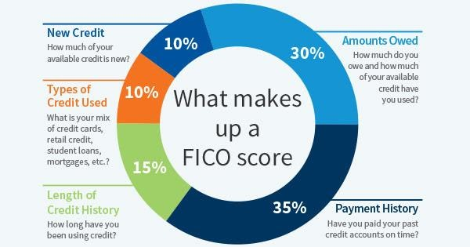
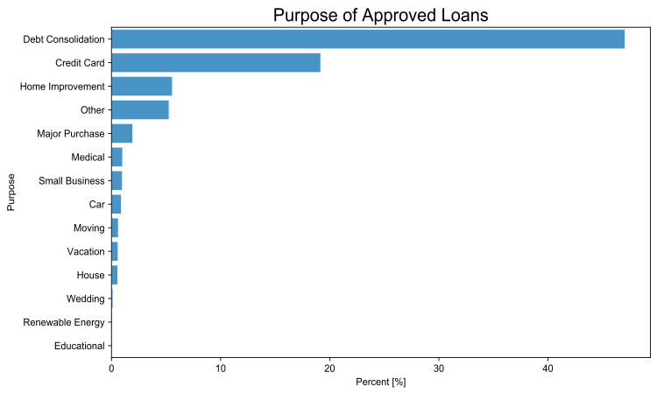
What is The Lending Club?
Background
Peer to peer (P2P) financing platform
Launched in 2006
Allows investors to fund loans based on applicant’s:
FICO score
Employment status
Length of employment
Loan purpose
Loan grade
Other self-reported information

Slide 6



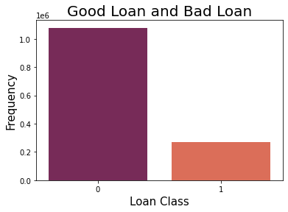
Dataset Size and Completeness
Description | Details
Unique Observations | 2.3Million
Number of Features | 151
Feature Types | Numerical, qualitative, datetime
Dates spanned | 2007 - 2018
Loan portfolio value | $34.01B
Missing values | 731K (31.8%)
Default
11.9%
Key Considerations
Not Default
88.1%
Class imbalance: Non-defaulted loans outnumber defaulted loans 6.7 : 1
Significant variable multicollinearity: Certain variables exhibit high multicollinearity which may introduce modeling issues for linear models
Outliers: Certain outliers may distort model coefficients and predictions and cause model to overfit

Slide 7


Machine Learning Modeling
Impact of false negatives to measure impact of lost interest income
Models Tested
Model Name | Model Type
Logistic Regression | Linear
Gradient Boosting Classifier | Tree-ensembling
Catboost Classifier | Tree-ensembling
Neural Net | Deep Learning
Impact of false positives to measure impact of loan principal loss
Measuring Model Performance
ROC_AUC Score takes into account

Slide 8


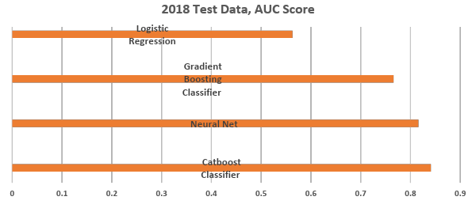
June 2021
Tree-ensembling methods largely outperform linear models
Model Name | 2018 AUC Score
Catboost Classifier | 0.841
Neural Net | 0.816
Gradient Boosting Classifier | 0.766
Logistic Regression | 0.563
Results

Slide 9

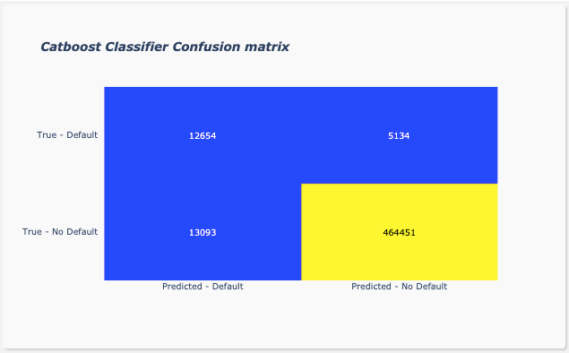
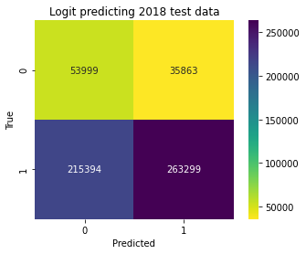
Visualizing Results
Since false positives are more harmful than false negatives, precision score is the most important metric to track
June 2021

Slide 10

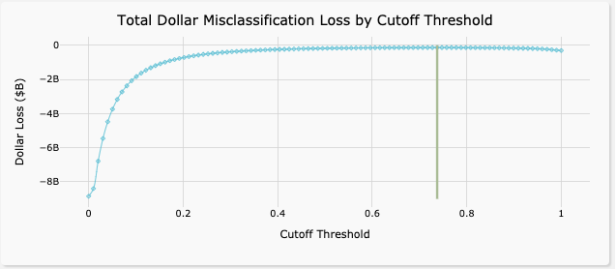
Tuning CatBoost Cutoff Threshold
Capturing Dollar Cost of Model Misclassifications
Why does a high cutoff threshold make sense in this classification setting?
Principal loss of defaulted loans (=0) that were predicted as good (=1) should be expected to outweigh the lost interest income of non- defaulted loans (=1) that were predicted as bad (=0) in the aggregate
Cutoff value of 0.7374 minimized dollar misclassification loss

Slide 11


Portfolio Optimization Results
Portfolio Description | 36months loans IRR | Δ vs. Catboost | 60months loans IRR | Δ vs. Catboost
Catboost Portfolio | 7.40% | 0.00% | 10.63% | 0.00%
Lending Club Historical IRR* | 6.30% | -1.10% | 8.11% | -2.52%
Baseline Model** | 5.89% | -1.51% | 9.67% | -0.96%
Capital Allocation Rule:
For 2018 loan set, leverage CatBoost predictions to allocate capital to loans predicted as ‘good’ and to deny investment for loans predicted as ‘bad’
Two-sample t-test of our model portfolio against the baseline portfolio further shows these results are statistically significant to the 1% level, and that our model produces 1.51% and 0.96% of alpha for 36-month and 60-month loans respectively versus the baseline model portfolio
*Lending Club IRR inclusive of actual loan recoveries post-default
**‘Baseline’ model predicting all loans as ‘good’ loans indiscriminately

Slide 12
Recommendations
Conclusions
01
02
Objective of the project was to utilize machine learning models trained on 2012-2017 data to accurately predict loan defaults in the 2018 loan pool
On one hand, the analysis offered valuable insights on returns on the 2018 loan data for investors in The Lending Club Platform
And the other, the CatBoost Classifier model is the best performer among all the other models(undertaken) with the given data set and design
It minimized the loan defaulters and increased investor returns
The project adds more value to the business of fintech industry where we could increase the investor’s ROI applying machine learning models and assuring a good return to attract more investors to invest in similar types of loans
Project scope can be enhanced with more realistic industry specific future directions
jayarethanampillai.com
03
04
Adjusting probability thresholds depending on different loan grades/terms will align with industry standard approach to better predict risky loans
Accordingly, we can define the cost of risks or internal rate of return more realistically for a financial domain

Slide 13


Check out my website for more projects
Website
www.jayarethanampillai.com
Email Address
infojayapillai@gmail.com
Social Media Handle
@jayarethanampillai
LinkedIn
https://www.linkedin.com/in/drjayapillai/

Slide 14



Thank you
infojayapillai@gmail.com

